Slide 1
Lake Management Committee
August 2026 Agenda
Call to order
Attendance
Approve minutes 4/26
Chloride -2026 graphed
Wakesurfing update
AIS
Fireworks
Fishery
Shoreline permit changes effective April 2026
Moose Lake: high water
New business
Adjourn

Slide 2
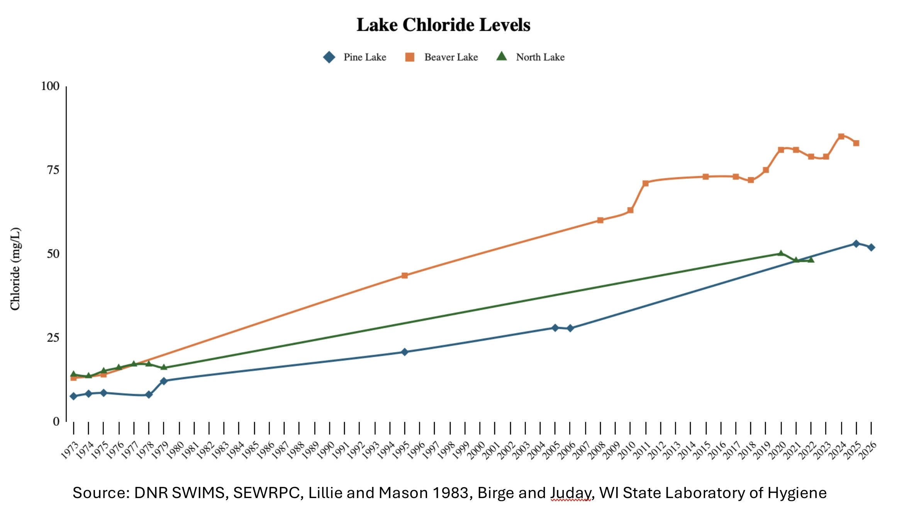
Chloride 2026- have shared with FOBL and CCC

Slide 3
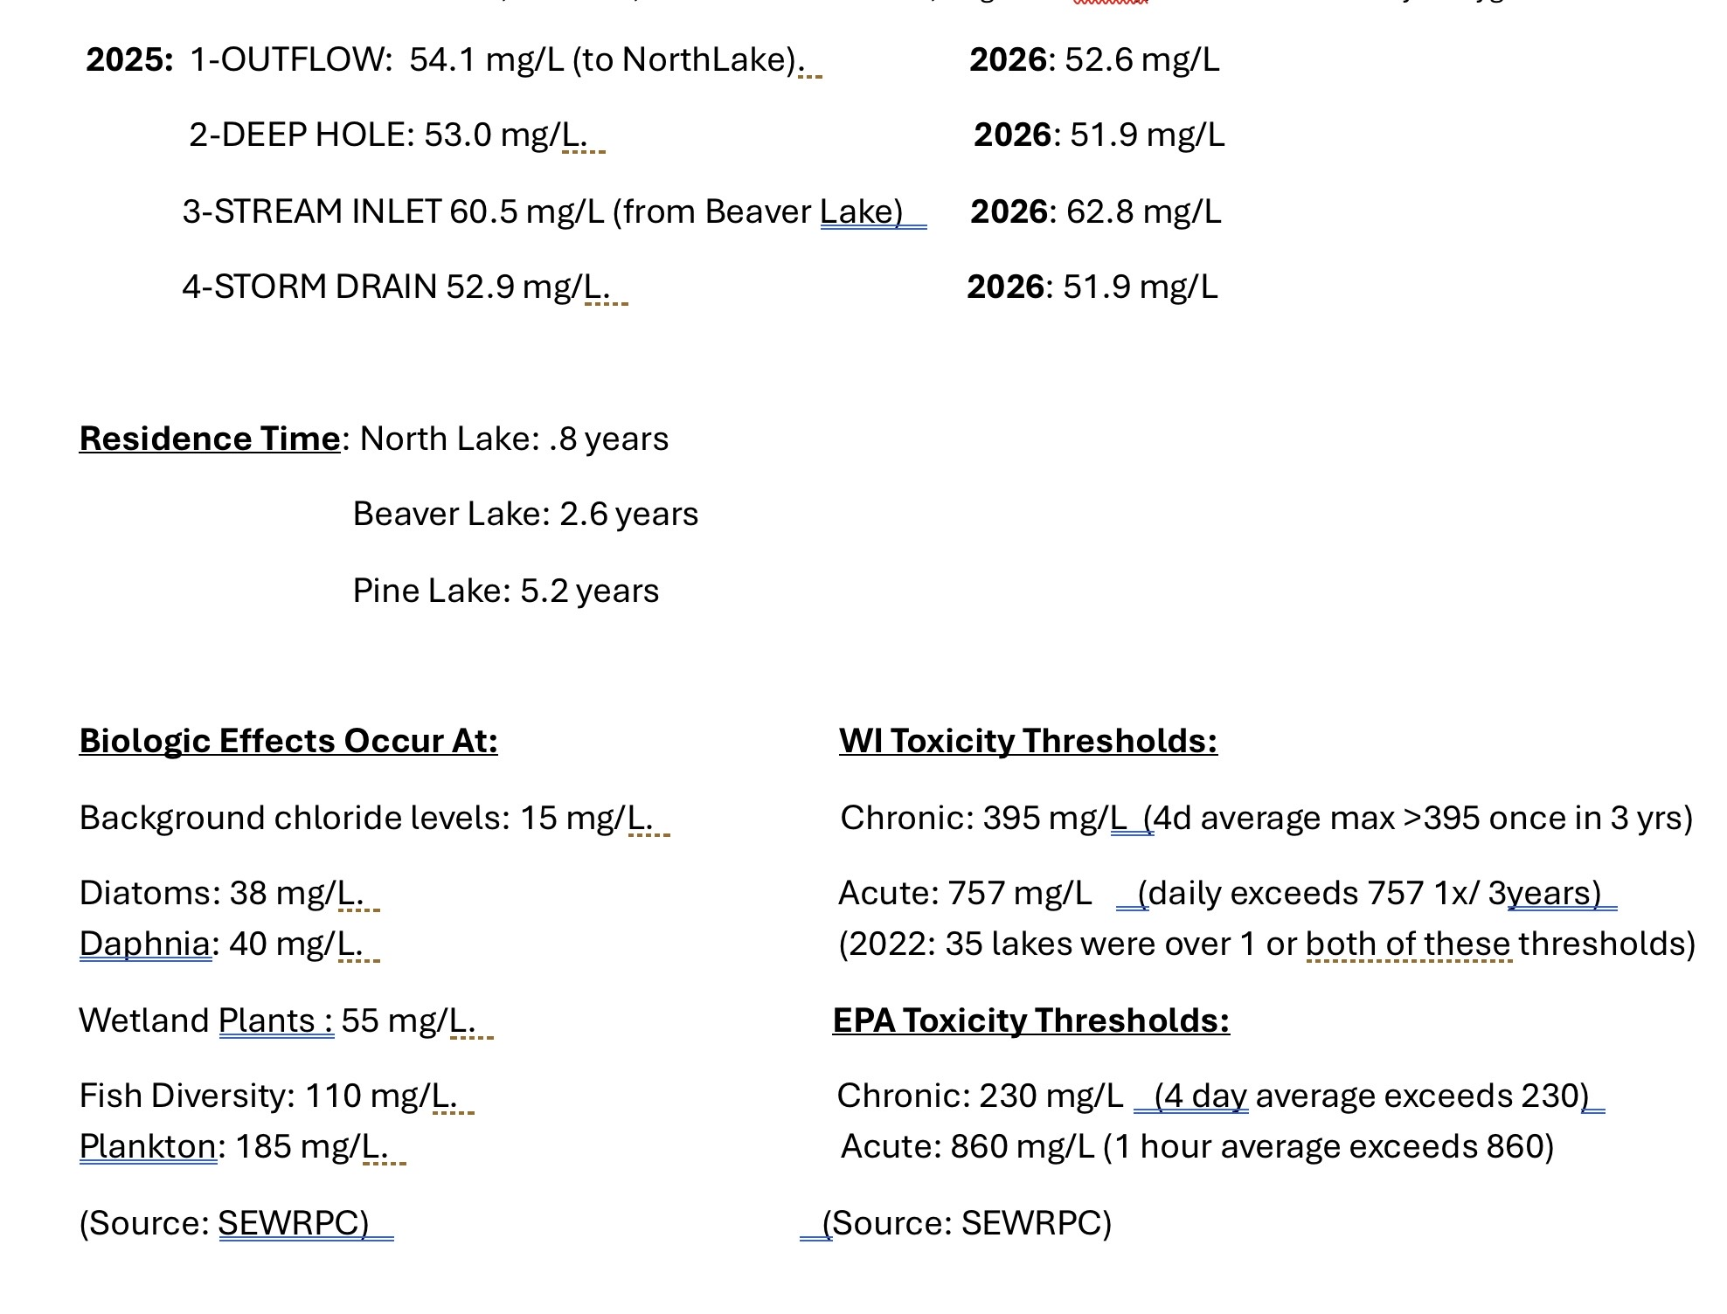

Slide 4
Wakesurfing Update
Town of Merton banned use of ballast and wakeshapers. You are allowed to wakeboard with a rope.
Town of Scott lawsuit: judge in federal district court said the plaintiffs had no standing to claim damages since they had continued to wakesurf after the ban. Town of Scott officials under oath testified they would not be enforcing. Wakesurfing continues. Constitutionality was not addressed re the Public Doctrine.
Eight other lawsuits
Town of Summit considering a 200/20 foot depth ordinance (our current)
Should we recommend our guidelines become an ordinance so CPD has enforceability? 200/20 and stay out of the bays?

Slide 5
AIS
New applicator, new treatment map 2026. Treating curly leaf pondweed and EWM.
Used 2,4D and Aquathol-K , no Procella Cor (more long lasting)
<5% of lake surface area was treated
Avoid areas with lots of native aquatic species
SEWRPC was on lake 2 ½ days,600 sites sampled > 27 species found, so good diversity, yes more starry stonewort than we thought though largest stands in Wilson’s Bay. Most common native species= muskgrass/chara, most common invasive= Eurasian milfoil, +hybrid.
Prelim report coming, final report plus management plan Spring 2027

Slide 6
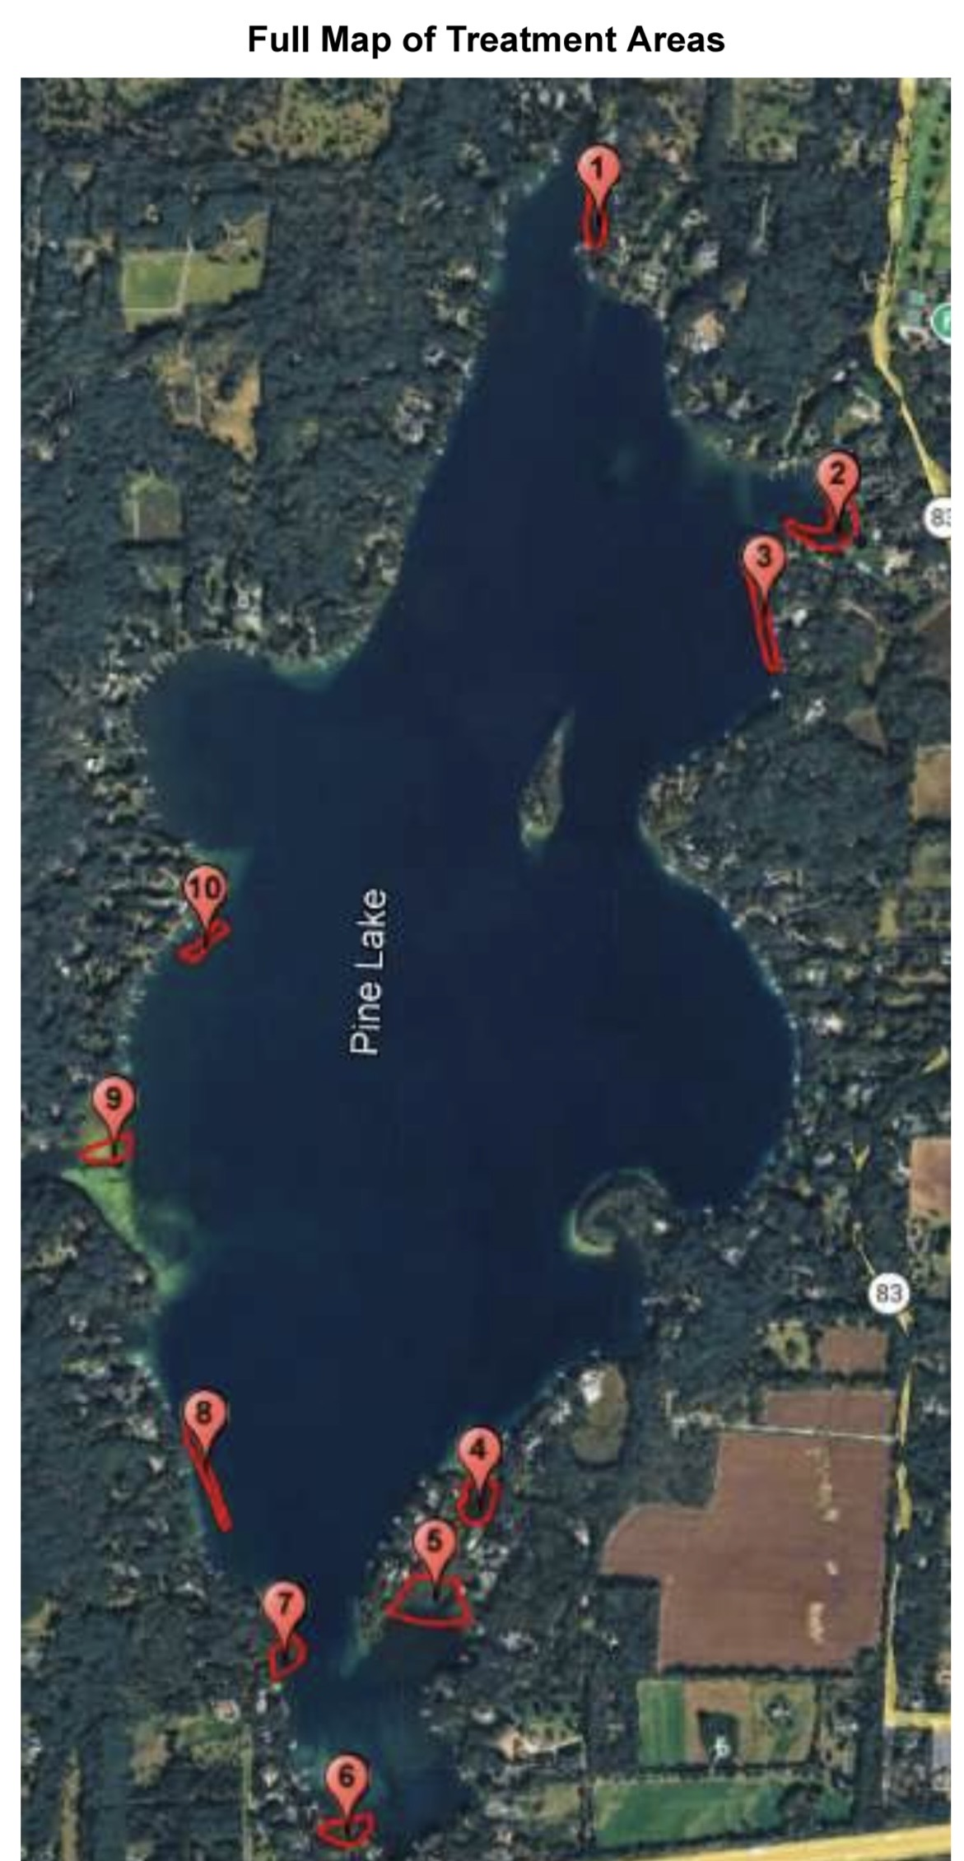
AIS 2026 Treatment Map

Slide 7
Fireworks: new studies since 10/25
EPA/Penn State: deposition and drinking water levels
EPA/TCU: deposition study, rate of breakdown. Only perchlorate:
Temporary spike as seen before, rapid drop with dilution, sedimentation, anaerobic breakdown in sediment, plant uptake
The larger the lake, the deeper the lake the faster the levels drop
Watershed deposition 10X direct deposition-we aren’t on a stream/river
Neither study addresses human impact
Still no drinking water level
EPA still treating this as “exceptional event”= temporary spike

Slide 8
Fishery-
Surveyed shoreline woody habitat last fall
Spring surveys of Fyke nets and electro-fishing
Results Spring 2027-another metric of lake health + land use
Prior we have been classified as “complex two-story”, deep cold-water lake capable of having Cisco though in decreasing numbers
Only 200/15,000 categorized as complex two-story in WI
Number of two-story lakes is decreasing as shorelines get developed, water temps warm, bottom of lakes get more anoxic
Species reflect land use/shoreline: if woody shoreline habitat removed➡️no perch, bass eat more terrestrially as prey fish are less, developed/armored shoreline and increased water temps➡️⬇️ cisco

Slide 9
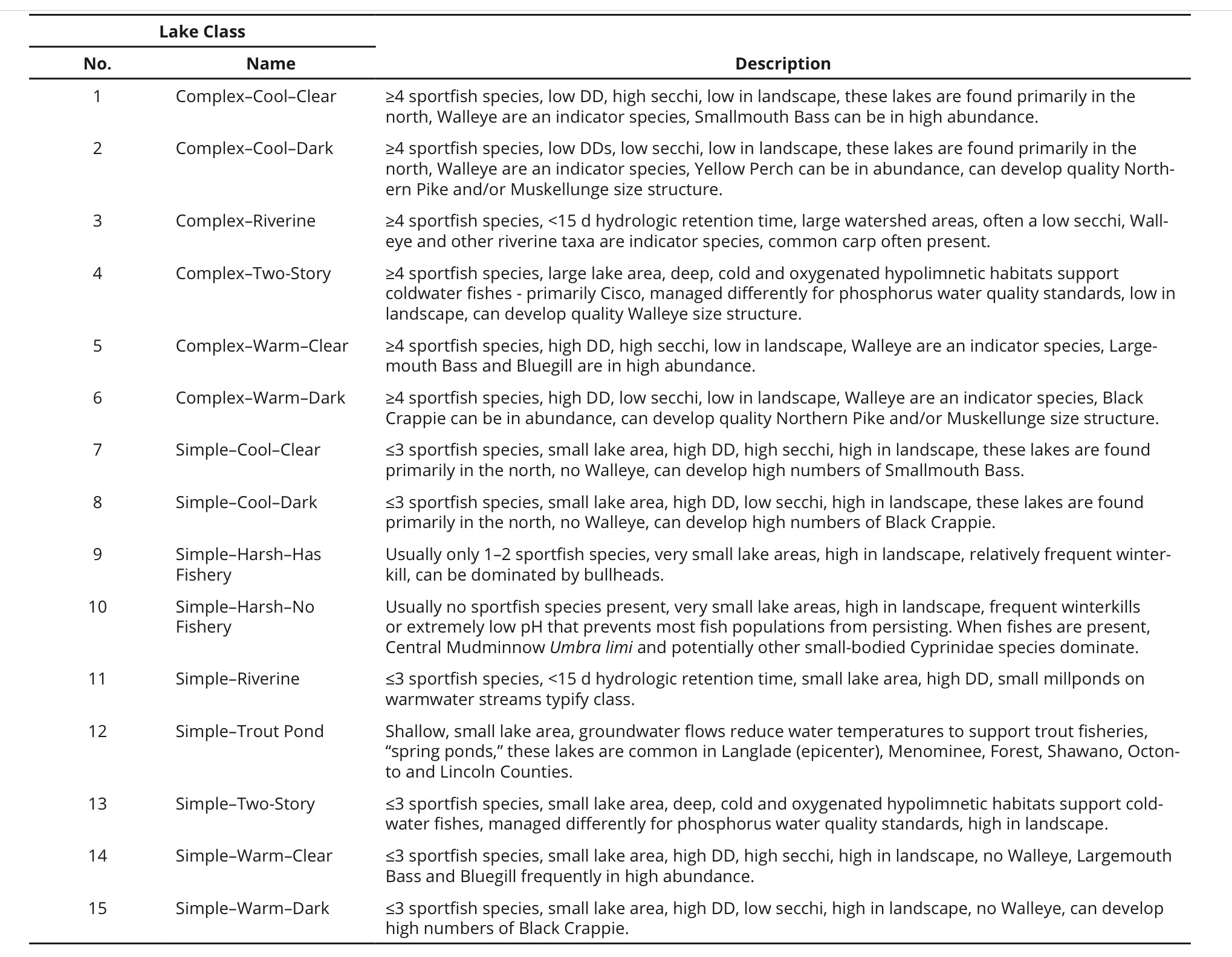

Slide 10
DNR Shoreline Permit Changes: effective April 2026
Rip-rap harder to get, must calculate energy level low medium high with depth and fetch calculation. Harder to get low energy permit, though qualifiers allowed. Armoring shores has negative consequences for lakes, must be used sparingly, must be justified.
https://dnr.wisconsin.gov/sites/default/files/topic/Waterways/checklist/Riprap_Exemption_Checklist_2026.pdf
Natural shoreline structures easier to get, if they require a permit at all.
https://dnr.wisconsin.gov/sites/default/files/topic/Waterways/checklist/Biological_Shore_Erosion_Control_Structures_Exemption_Checklist_2026.pdf
All work in water work: no work allowed during fish spawning times March 1-June 15

Slide 11
Moose Lake-chronic high water issues
High water since 2008
New Lake Management District was approved fall 2025 to address this: petition of 51% of riparian owners (not voting residents) approved by Waukesha County Board
Pursuing a civil engineering solution pumping/piping under C into Okauchee to a set lake level. DNR onboard, SEWRPC onboard
AIS/ chemistry issues to be addressed
We share an aquifer and groundwater; what effect will this have on wells on east side of Moose and west side of Pine, Brumder Road including Oakland?

Slide 12
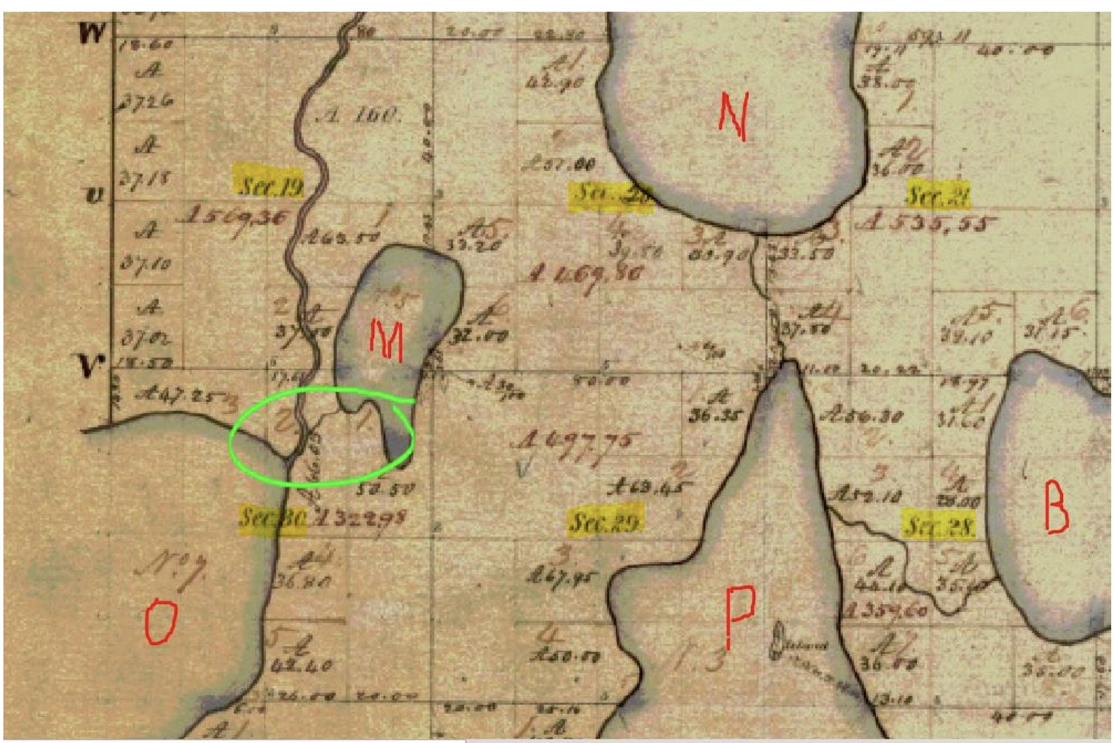
Was there historically a connection?

Slide 13
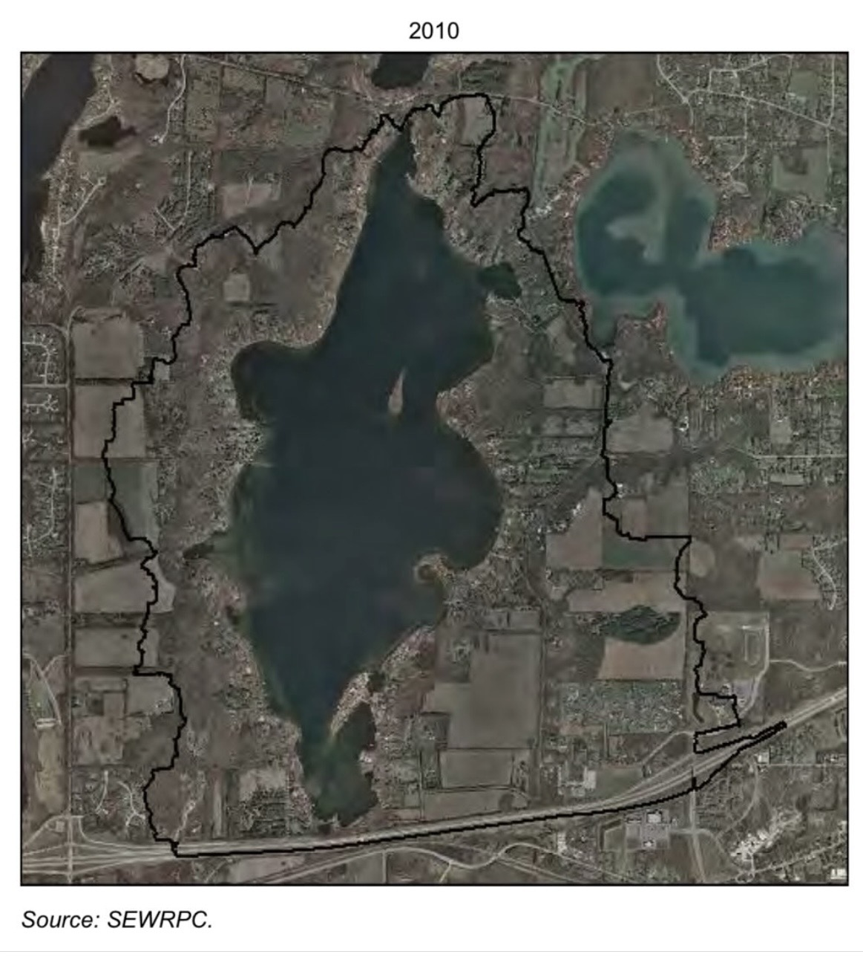
Watershed:

Slide 14
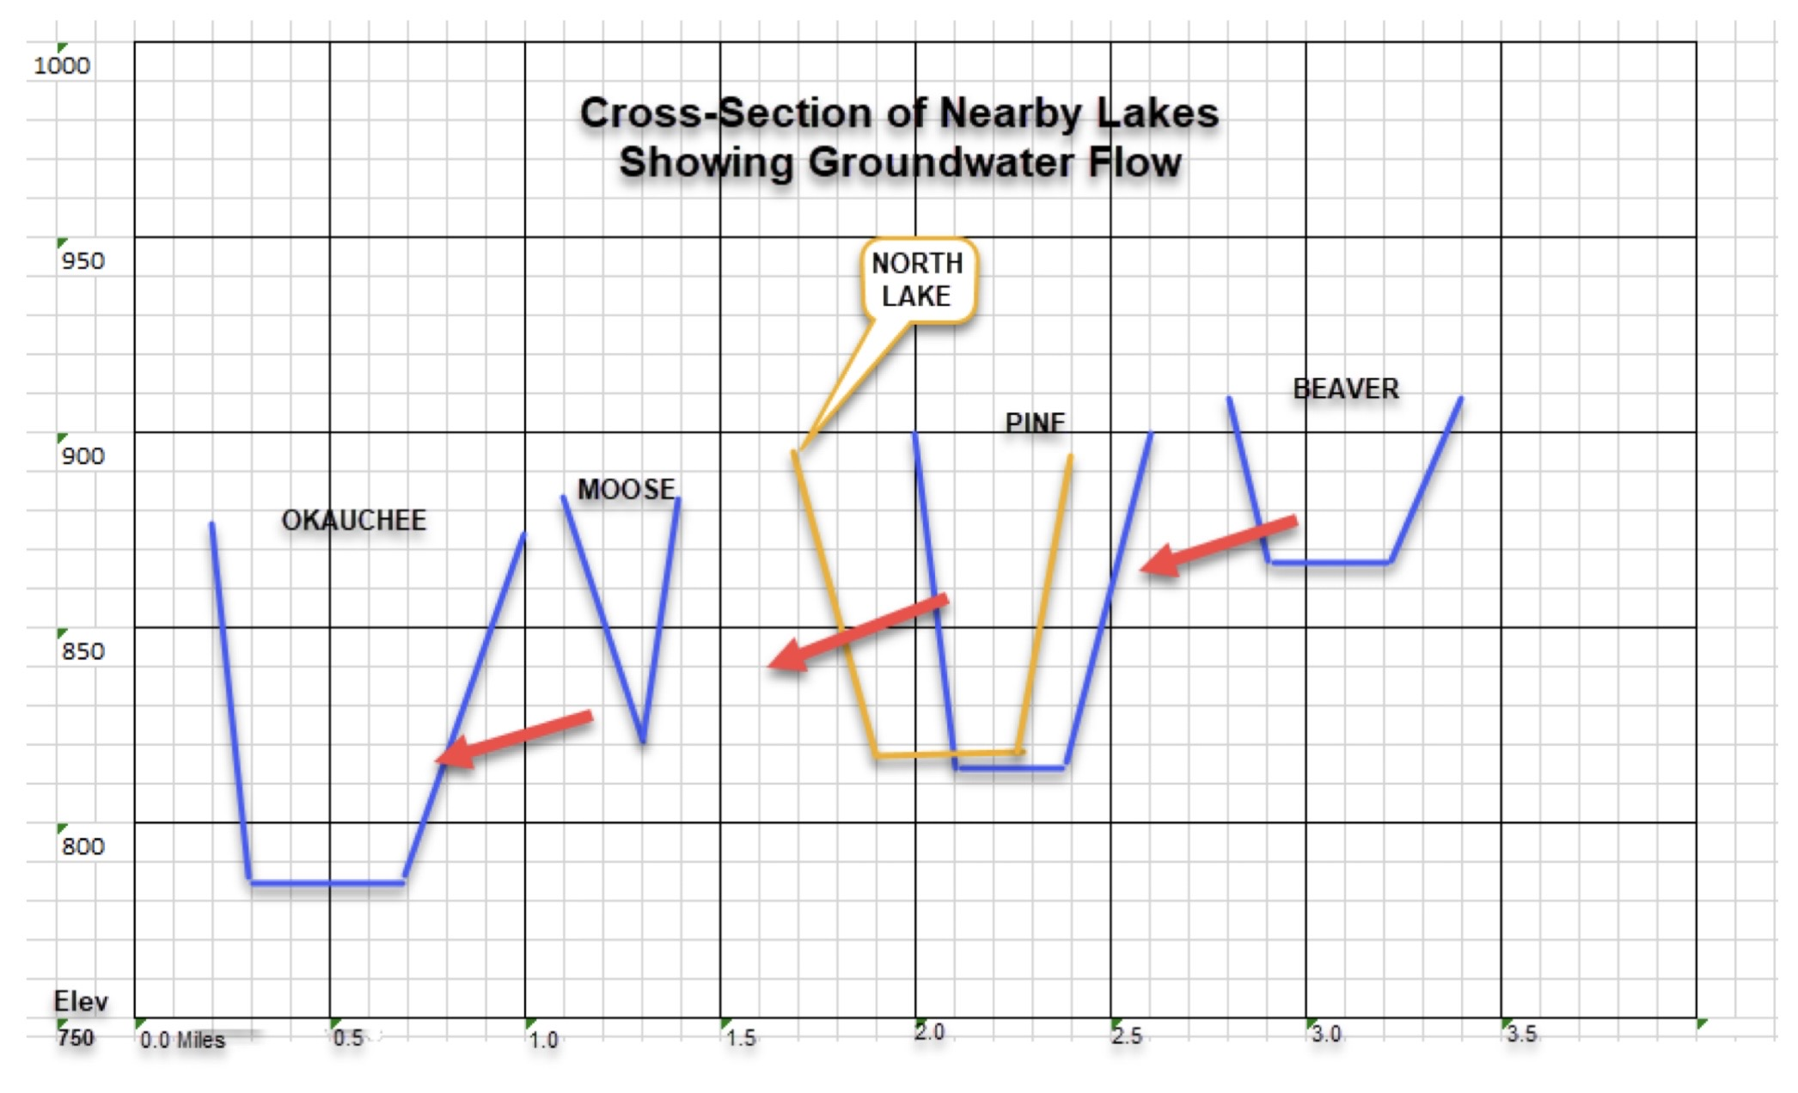
But ground water flow flows east to west

Slide 15
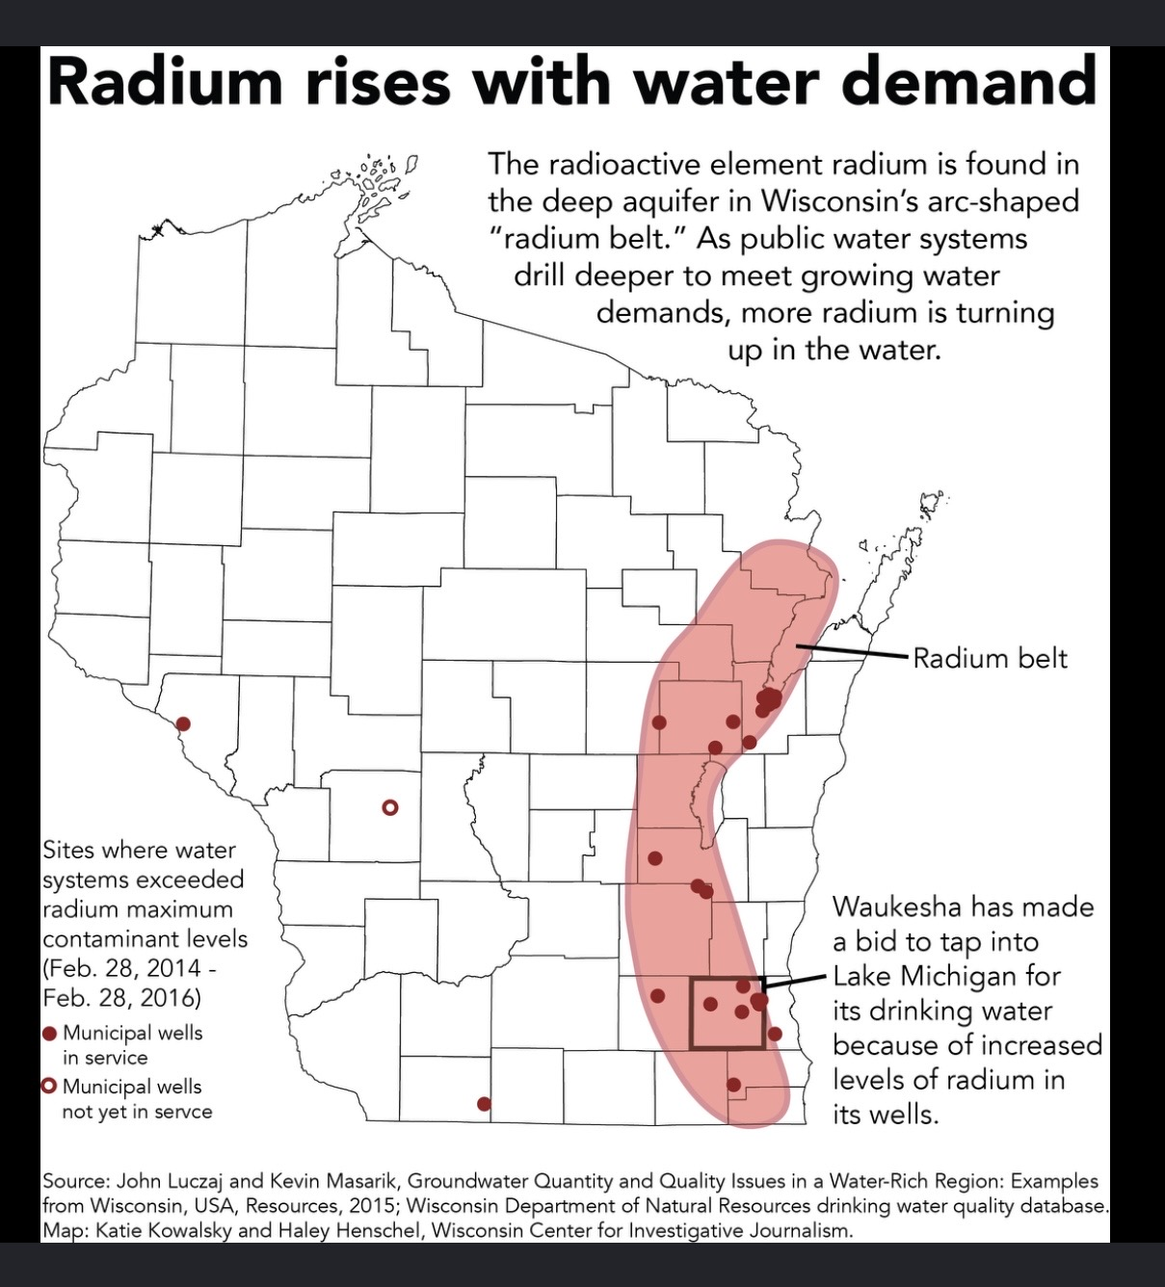

Slide 16
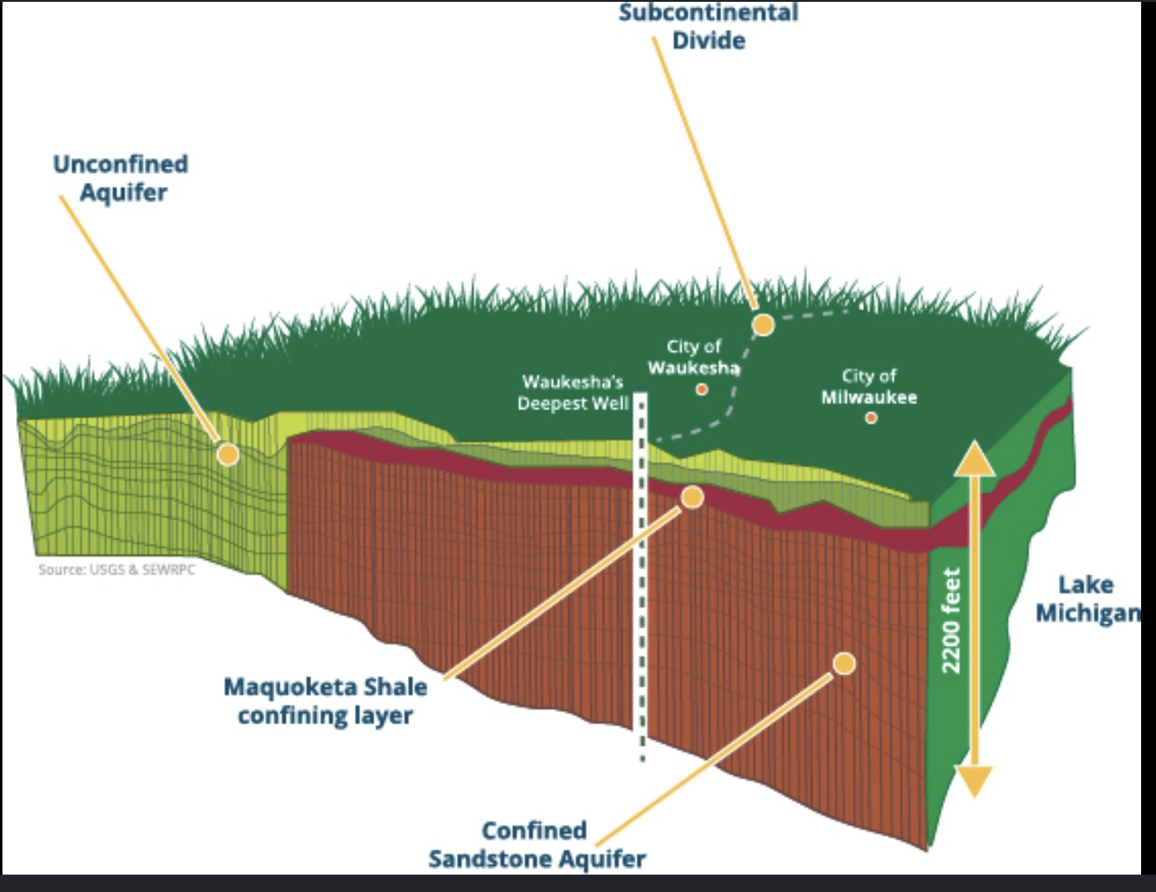

Slide 17
